Slide 1



Java swing
Quan ly quay thuoc

Slide 2

Member
01
02
03
04
HUYNH TIEN THANG
LE THAI TOAN
PHAN TRUNG NGHI
DOAN PHUONG VIEN

Slide 3
Teacher
Truong Ngoc Khac Nguyen

Slide 4
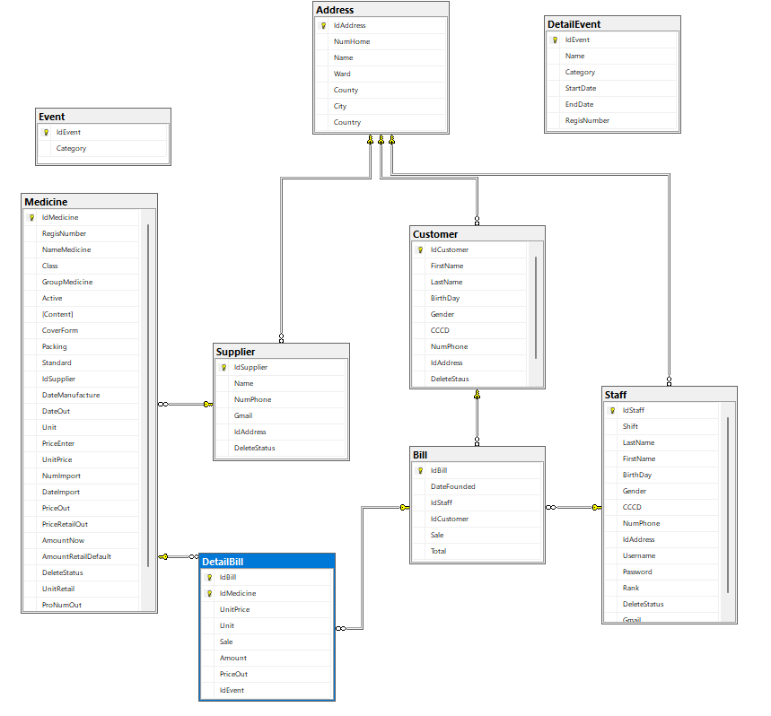
Database

Slide 5


Main function
Login ADMIN anb employee.
Employee.
BIll.
Medicine.
Customer.
Supplier.
Statistical

Slide 6


DEMO PRODUCT

Slide 7


THANKS FOR WATCHING <3

